Slide 2
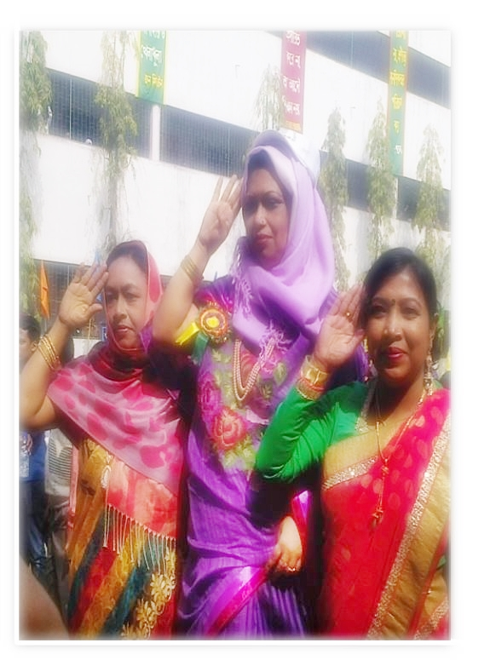
ME
ISMAT ARA MAMATAZ ASSISTANT TEACHER (ENGLISH) DHANMONDI GOVT. BOYS’ HIGH SCHOOL, DHAKA

Slide 3
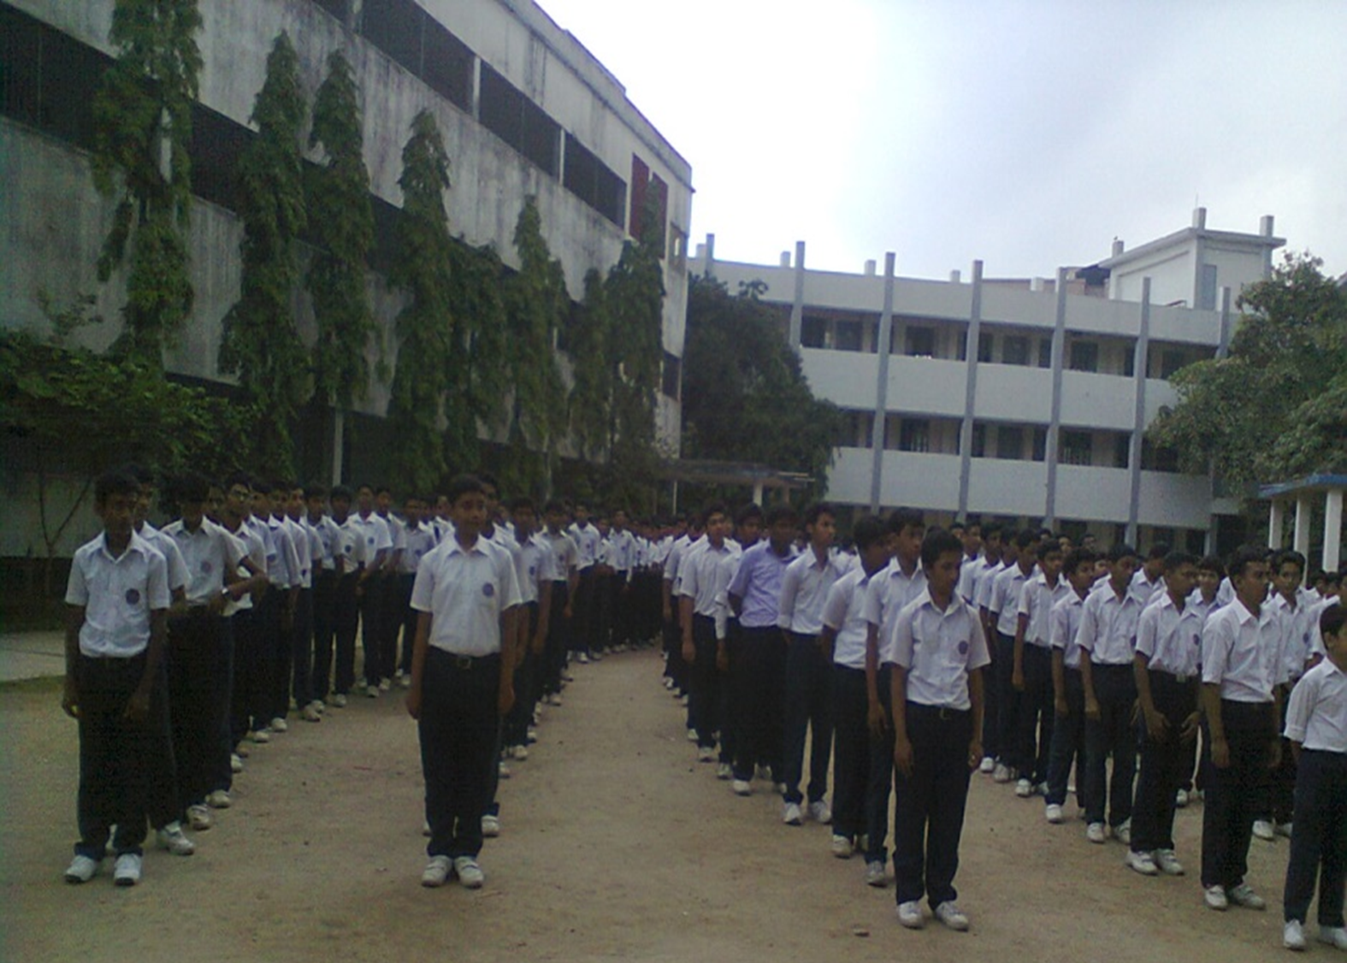
WELCOME
TO
ENGLISH 1ST PAPER CLASS
CLASS-VIII

Slide 4
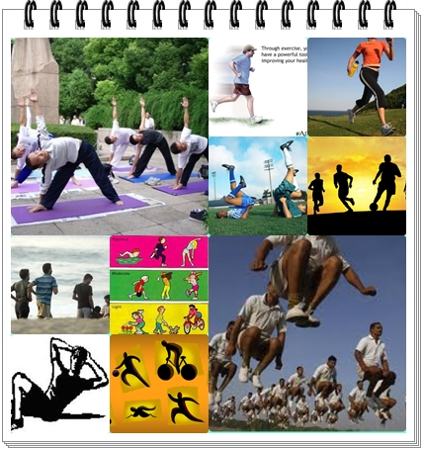
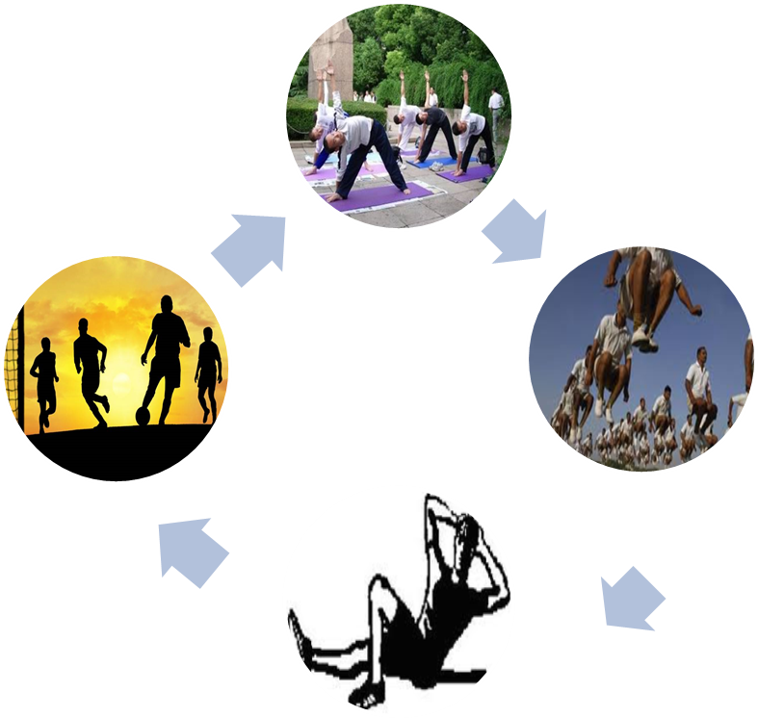
Look at the pictures and answer the questions.
what can you see in the pictures?
Do you go to play ground daily?
Do you take physical exercise regularly?
Notes:
After eliciting the answers from the learners he/ she can declare the topic.

Slide 5
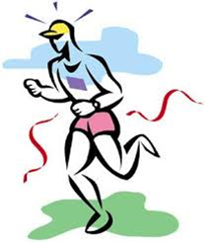
TODDAY’S TOPIC
Physical exercise
Lesson-6
Unit-3

Slide 6
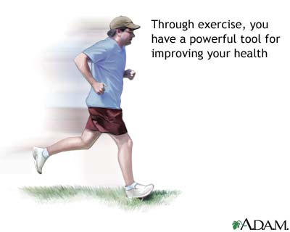
LEARNING OUTCOMES
By the end of the lesson the learners will be
able to…
ask and answer questions
explain the text
write the usefulness & importance of physical exercise

Slide 7
Work in pair-pre text reading activity
Look at the picture and talk about it with your partner. After that, answer the following questions.
1.Who can you see
in the picture?
2.What is he doing ?
3.Can you tell me
what it is called?
Notes:
After eliciting the answer the teacher can asked 1-2 students to say 5 sentences on the picture.

Slide 8
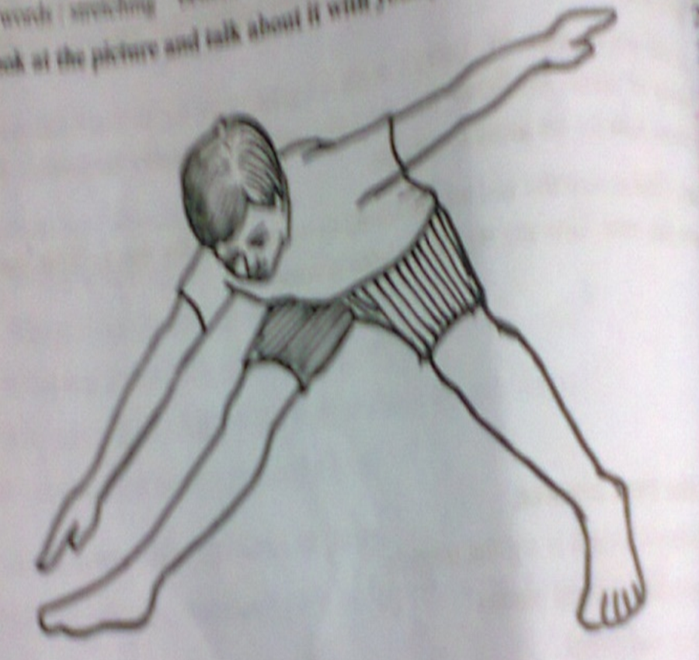
B.TEXT READING
Notes:
The learners will be asked for reading the text silently and I will monitor them. After they have Completed reading, They will answer some questions, match a table . I will elicit answers from them . Before that, the teacher can invite 2-3 students to pronounce some words so that they

Slide 9
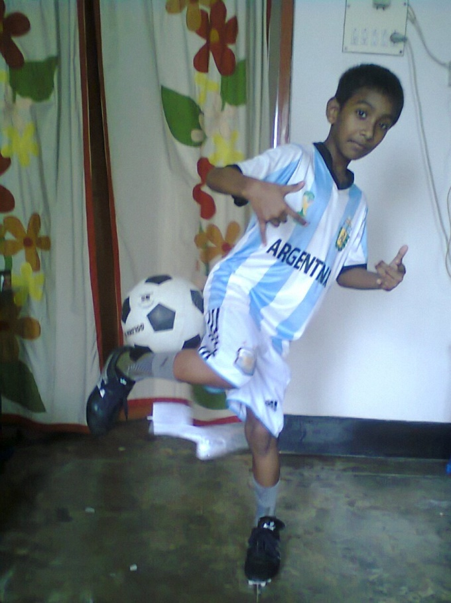
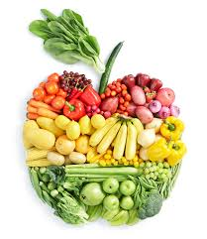
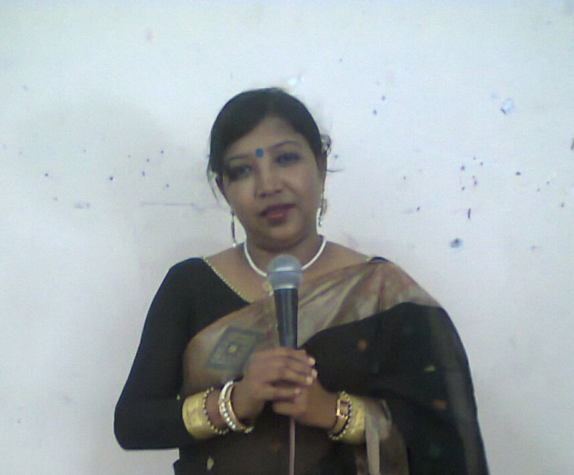
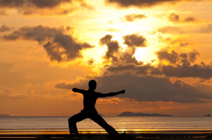
Physical(aDj)
[fiz-i-kuh l]
Of the body or pertaining /
relating to the body
The Mind-Body Connection
The Mind-Body Connection
As they eat healthy foods and take exercise regularly, they have physical fitness to do any work.

Slide 10
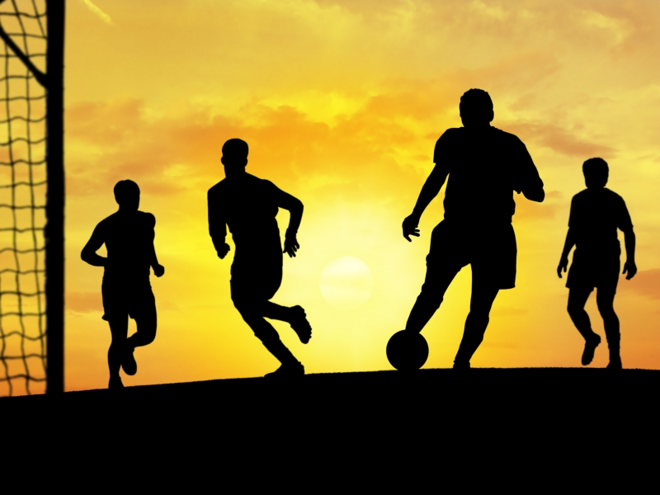
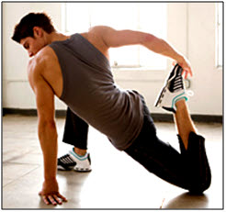
PHYSICAL EXERCISE
Physical exercise is any bodily activity that enhances or maintains physical fitness and overall health and wellness.

Slide 11
Benefit
Something that promotes or enhances well-being; an advantage
The benefit of physical exercise is
that it gifts a healthier happier life to humans .
noun

Slide 12
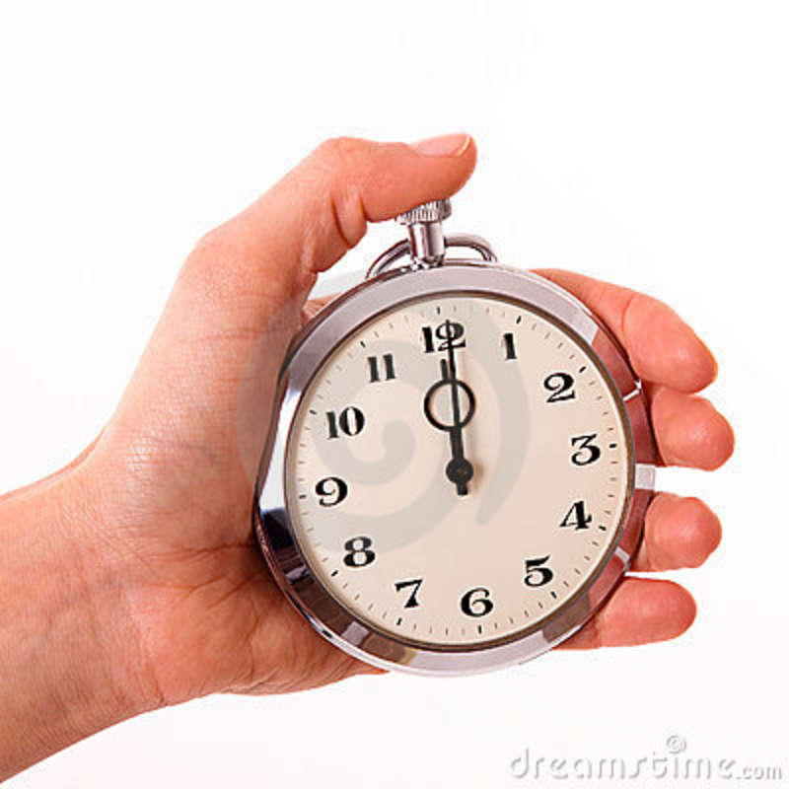
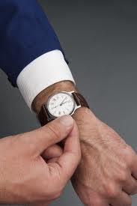
PUNCTUALITY
orderliness, being on time
We should have the knowledge about punctuality
so that in all the time we can be on time.
noun

Slide 13
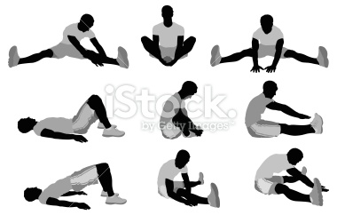
STRECH
u.k.
u.s.
distend
widen,
to lengthen
to lengthen, widen, or distend shape.
Notes:
The teacher can ask the students to prono

Slide 14
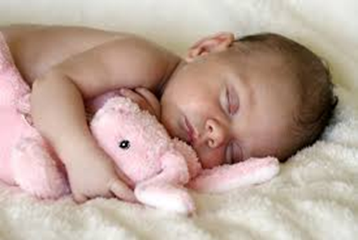
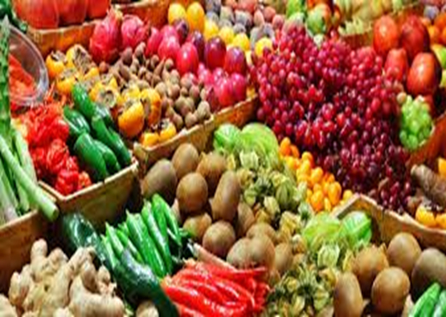
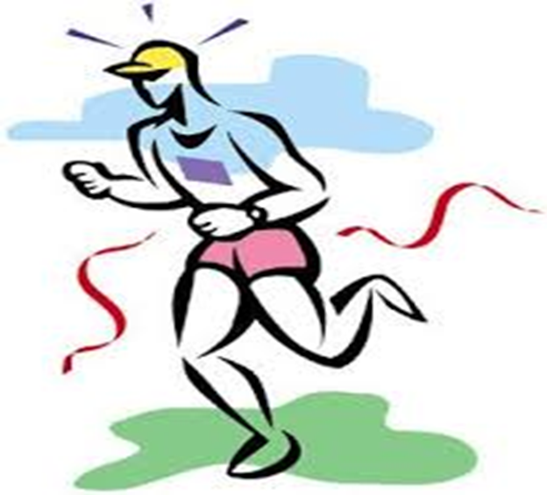
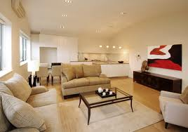
PROPER REST AND SLEEP
Being/keeping
Regular physical exercise

Slide 15
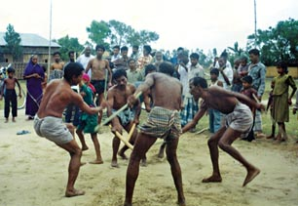
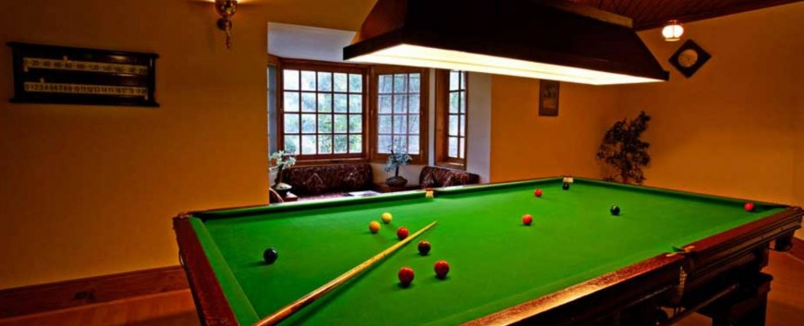
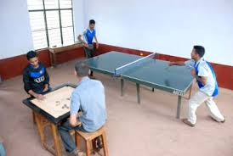
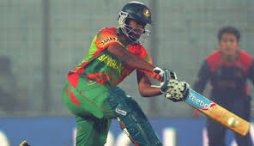
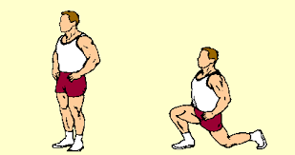
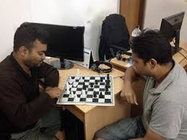
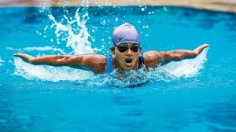
Different types of physical exercise:
Showing pictures I will explain the activity.
Outdoor games
Indoor games
Free hand exercise

Slide 16
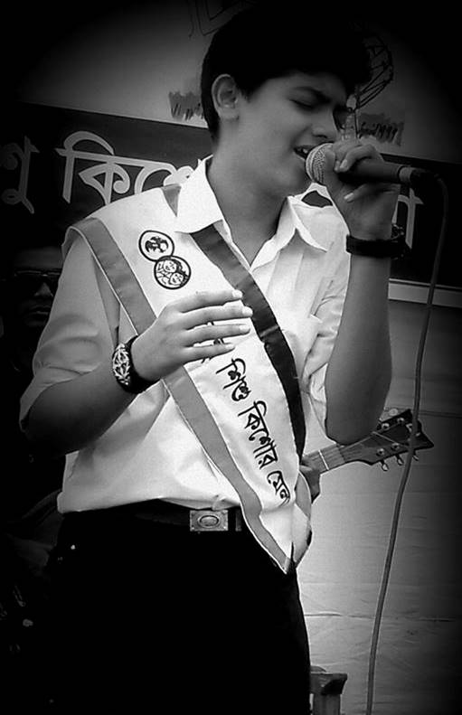
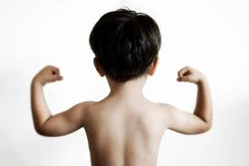
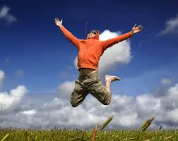
Why do we need physical exercise ?
to be
strong
to be cheerful

Slide 17
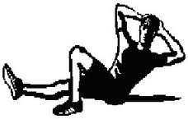
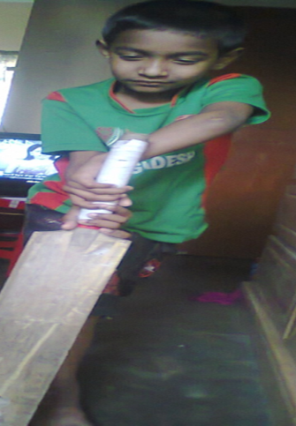
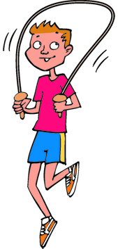
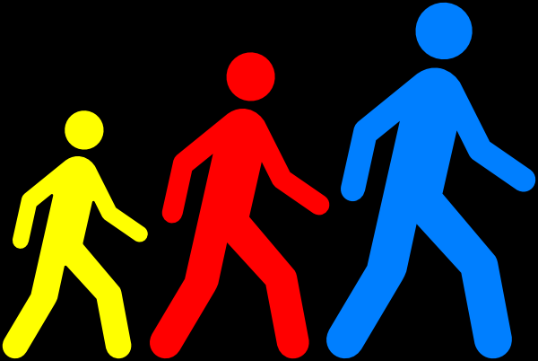
C. A list of indoor and outdoor exercises, Now go to board and write which ones are indoor and outdoor games
1.Playing sports
2.Swimming
3.Skipping
4.Jogging
5.walking
6.stretching

Slide 18
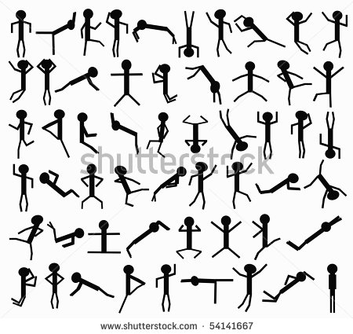
INDIVIDUAL WORK
Answer the following questions.
Which things are necessary for good health?
Name the different types of physical exercises?
Why do we need to take physical exercise ?
What type of physical exercise do we do?

Slide 19
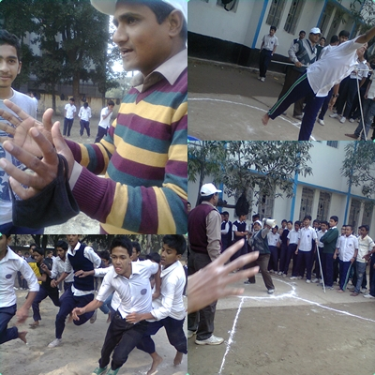
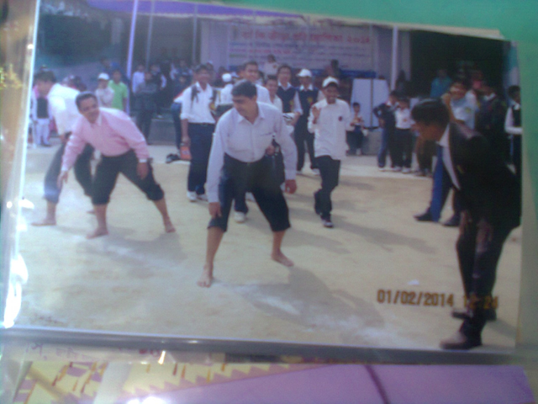
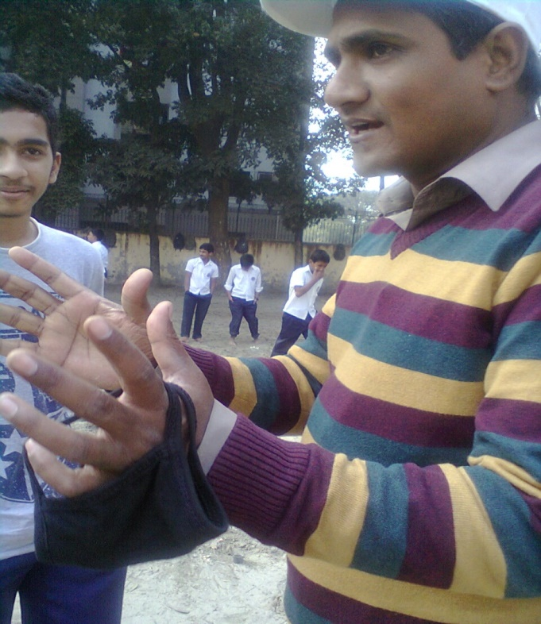
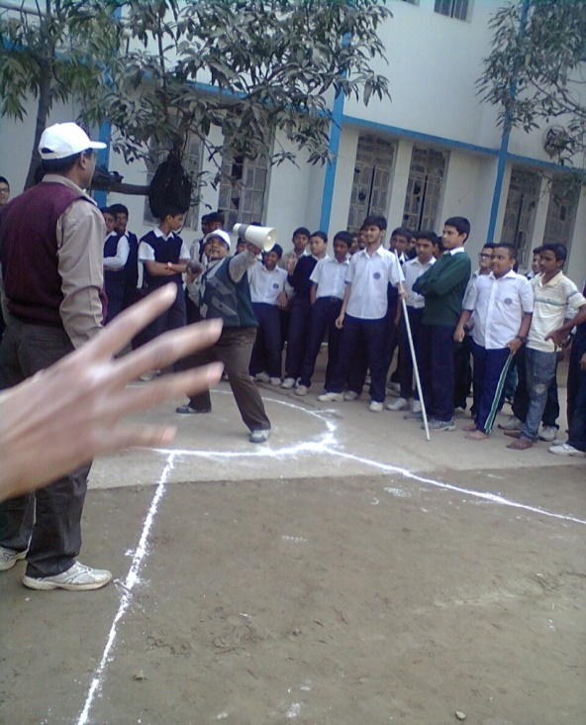
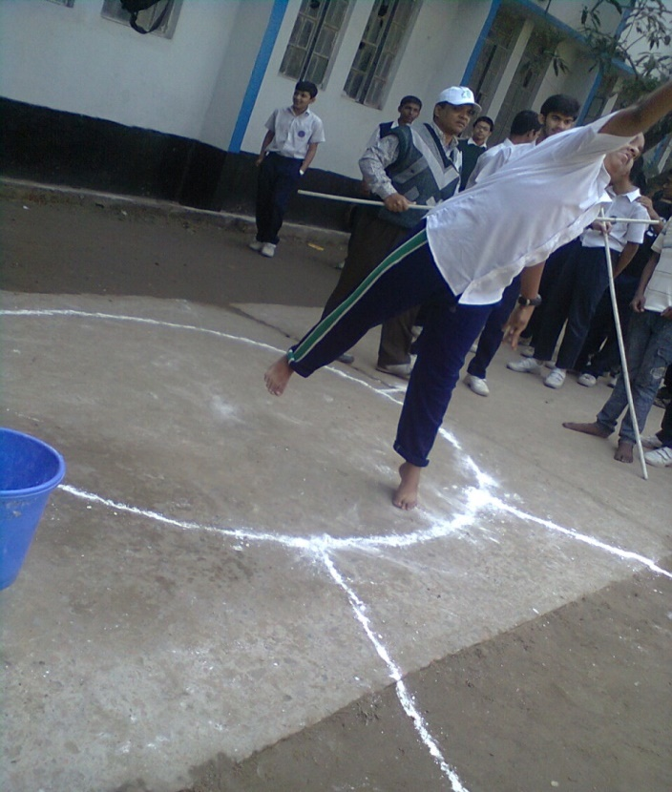
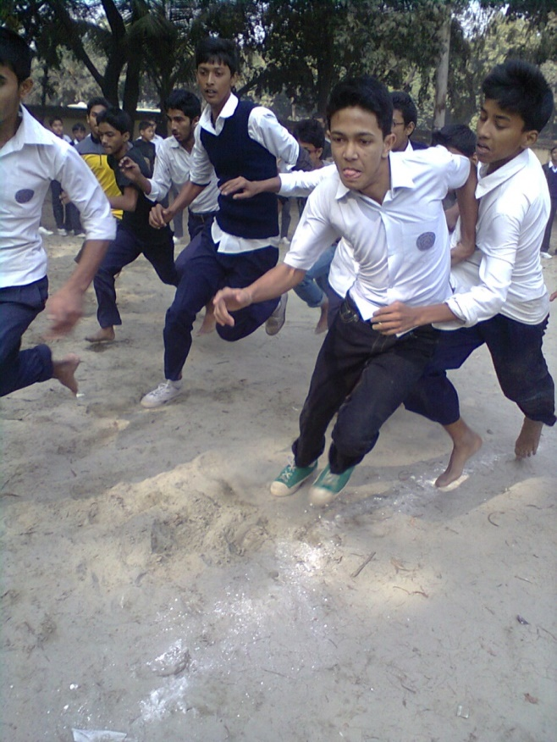
WORK IN GROUPS
Do you have a physical education teacher in your
school? How does he help you to do physical exercise?
If you do not have any physical education teacher, how do you
do this activity. Discussing the activity from the pictures,
write down them on your script in groups.
Notes:
The teacher can ask the learners if they don’t have any

Slide 20
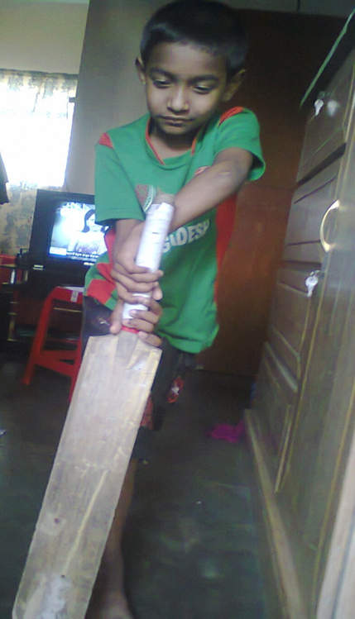
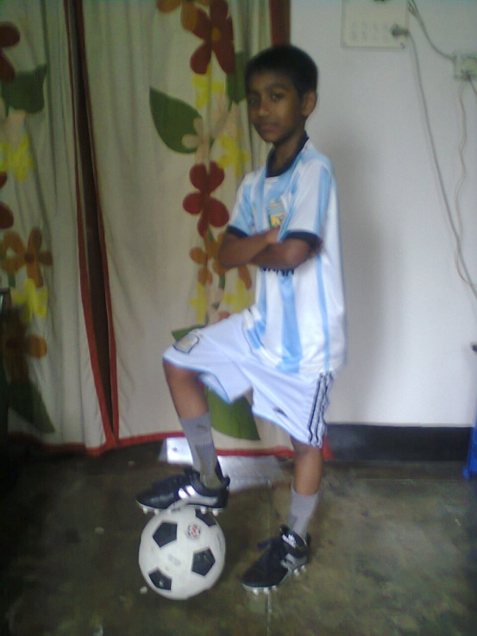
HOME WORK
What’s your favourite sport? Do you take
part in it? If so , where do you play it and
who with? Now write a paragraph on it
answering the above questions?

Slide 21
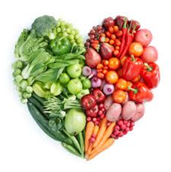
TAKE EXERCISE, PROPER REST AND SLEEP,
EAT GOOD FOOD
&
REMAIN HEALTHY.
THANK YOU A LOT

Slide 22
Acknowledgement
MoE, DSHE, NCTB & A2I respective officials
And the editors panel:
Mr. Ranjit Poddar, Associate Prof, TTC, Dhaka,
Mr. Md. Jahangir Hasan, Asst. Prof, TTC, Rangpur,
Urmila Khaled Asst. Prof, TTC, Dhaka.
Their direction, valuable suggestions and intensive supervision have enriched the model contents.

